Slide 1
INTERNSHIP
REPORT
Software Development – Paramount Software Solutions
Agam Aggarwal

Slide 2

Paramount Software Solutions
Paramount Software Solutions Pvt Ltd. is a software development company specializing in tailored solutions that align with the ever-evolving technical, business, and cultural needs of businesses. Their mission is to safeguard clients' investments while staying ahead of technology trends. They aim to provide innovative solutions to complex technical challenges without disrupting organizational cultures and traditions. Paramount's commitment to excellence is reflected in their diverse team and collaborations across various industries and technologies.

Slide 3
Tasks – 1) Designing a report, in which the companies that provide food traceability solutions to the firms in this sector are listed. Companies from Europe, USA, India. 2) Understanding the role of Radio Frequency identification(RFID), IOT and blockchain in this industry. 3) How AIDC-Automatic Identification and Data Collection is a very crucial aspect in the process of farm to plate. 4) Working on software development with a ongoing project of F2P-Inventory-Service and designing required API’s for it. 5) Understanding Node.JS , GIT, postman, MongoDB for successful implementation of API.

Slide 4
About Project
An inventory service project is a software application or system designed to efficiently manage and track various types of inventory within an organization. This type of project is commonly used across industries such as retail, manufacturing, logistics, healthcare, and more.
# Inventory Management: The core function of an inventory service project is to help organizations keep track of their inventory, which can include physical goods, raw materials, finished products, equipment, or even digital assets. It provides a centralized system for recording, organizing, and monitoring inventory levels.
# Real-time Tracking: Many modern inventory service projects leverage technology like RFID (Radio-Frequency Identification), barcoding, or IoT (Internet of Things) to enable real-time tracking of inventory items. This ensures accurate and up-to-date information about stock levels.
# Stock Control: The project helps in optimizing inventory levels by providing insights into reorder points, safety stock, and demand forecasting. It ensures that organizations have the right amount of inventory to meet customer demand without overstocking.
# Order Management: Inventory service projects often integrate with order management systems to streamline the process of fulfilling customer orders. They help in picking, packing, and shipping items efficiently.
# Reporting and Analytics: Inventory service projects generate reports and offer analytics to help organizations make informed decisions. This can include inventory turnover, aging reports, and sales trends.
# Multi-location Support: For larger organizations with multiple warehouses or stores, the project typically supports multi-location inventory tracking, ensuring visibility across different sites.

Slide 5
Project Details
Technical Stack
JavaScript, NodeJS, Postman, MongoDB.
The project involves managing and tracking inventory-related data in a database, and the API serves as the server-side logic for handling various endpoints related to user management, such as signing up and logging in users.
# Express at the Helm: The code utilizes the Express.js framework, a popular choice for building web applications in Node.js.
# Authentication: It focuses on user authentication and includes routes for user login and signup.
# JSON Web Tokens (JWTs): After successful login, the code generates JSON Web Tokens (JWTs) for secure user authentication and authorization.
# User Database: User data is managed within an in-memory database (represented as users in the code), where user information is stored for authentication and authorization.
#Server Setup: The Express application is configured to listen on a specific port, ensuring it's ready to accept incoming requests.
#Error Handling: The code includes error handling mechanisms to gracefully manage unexpected issues and provide informative responses.
# Data Validation: While not shown in the provided code, it's crucial to include data validation to ensure the integrity of user inputs and protect against potential security vulnerabilities.
https://drive.google.com/drive/folders/1Gp9Q-qKTzBAv3fL4PatkC_SKy9ia-Rpf

Slide 6
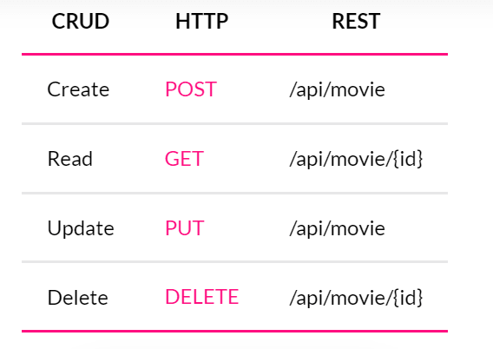
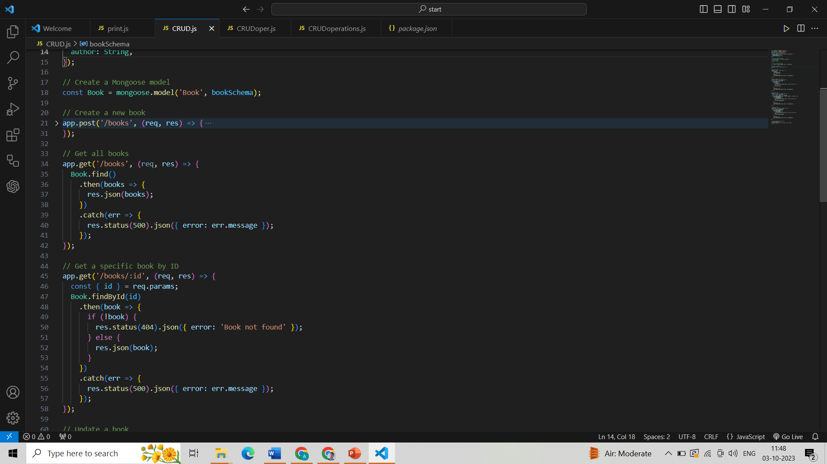
CRUD Operations
CRUD is the acronym for CREATE, READ, UPDATE and DELETE. These terms describe the four essential operations for creating and managing persistent data elements.
For starting with the development task I was told to design crud operations in js for understanding the basic interface and structure of the code.

Slide 7
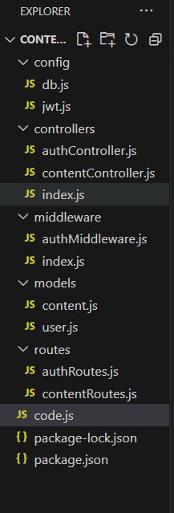
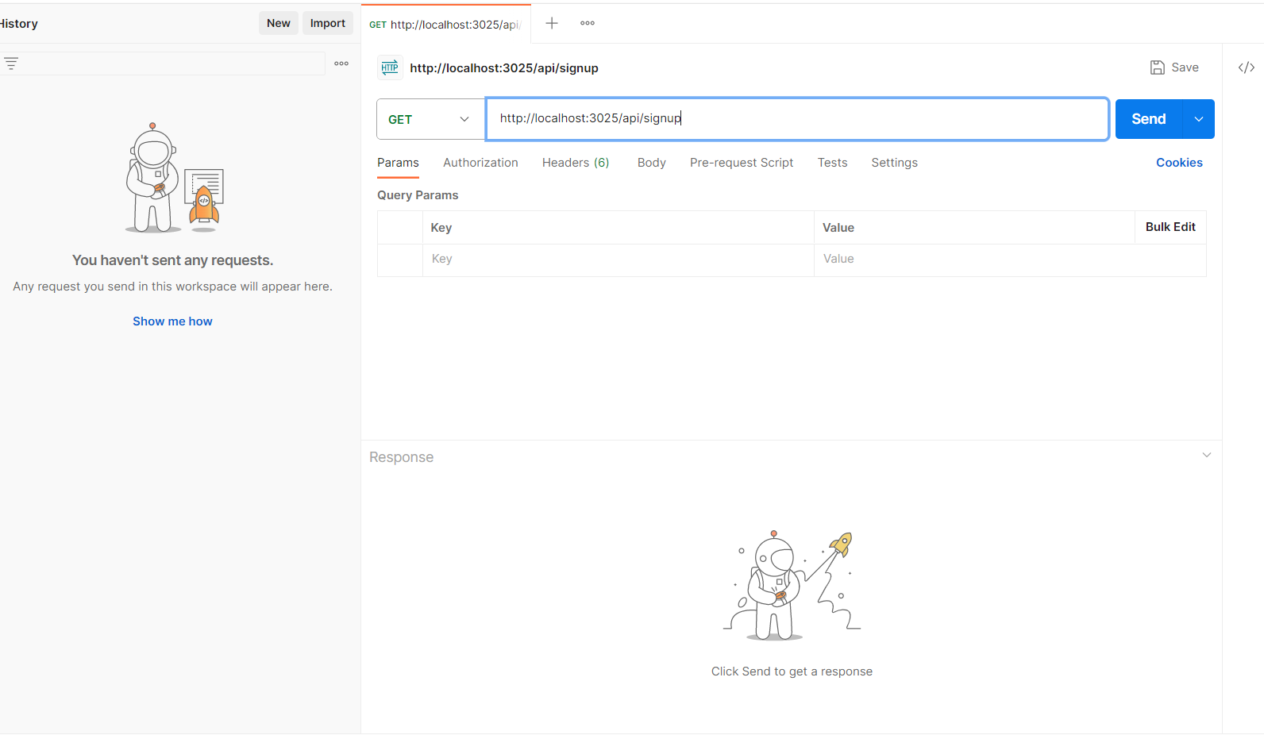
List of all the route files
Postman interface for testing

Slide 8
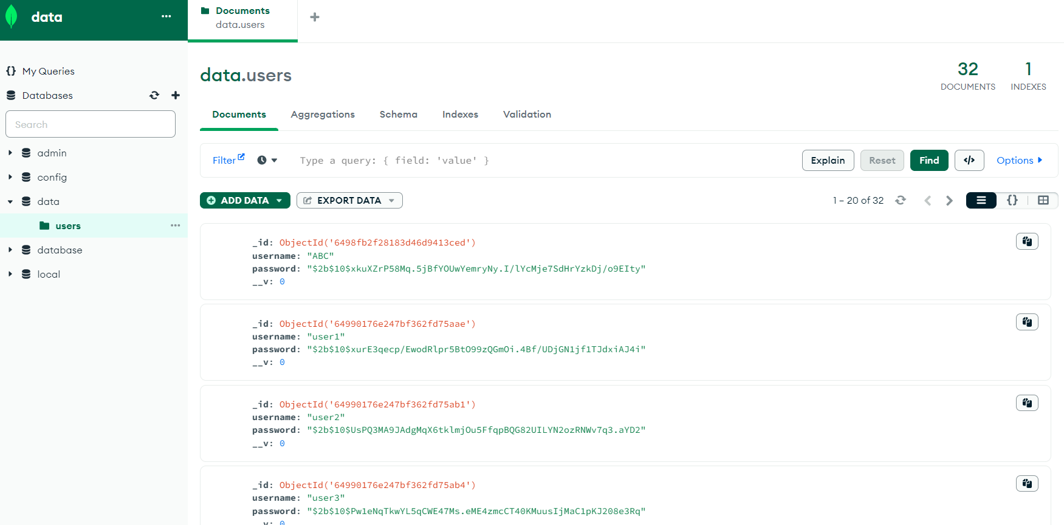
{
"email": “ABC",
"password": “ABC"
}

Slide 9
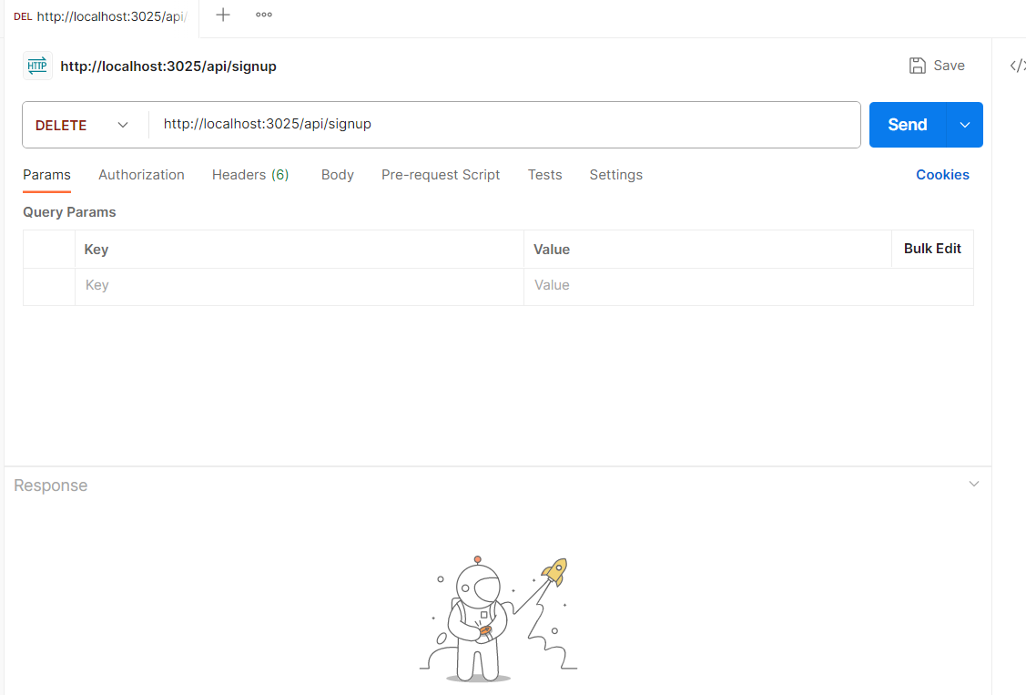
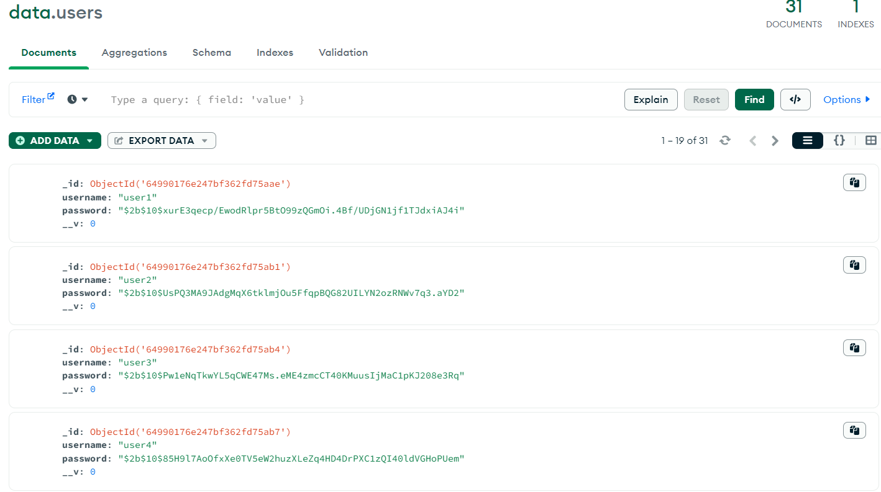
MongoDB compass
{
"email": “ABC",
"password": “ABC"
}

Slide 10
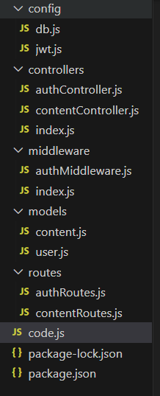
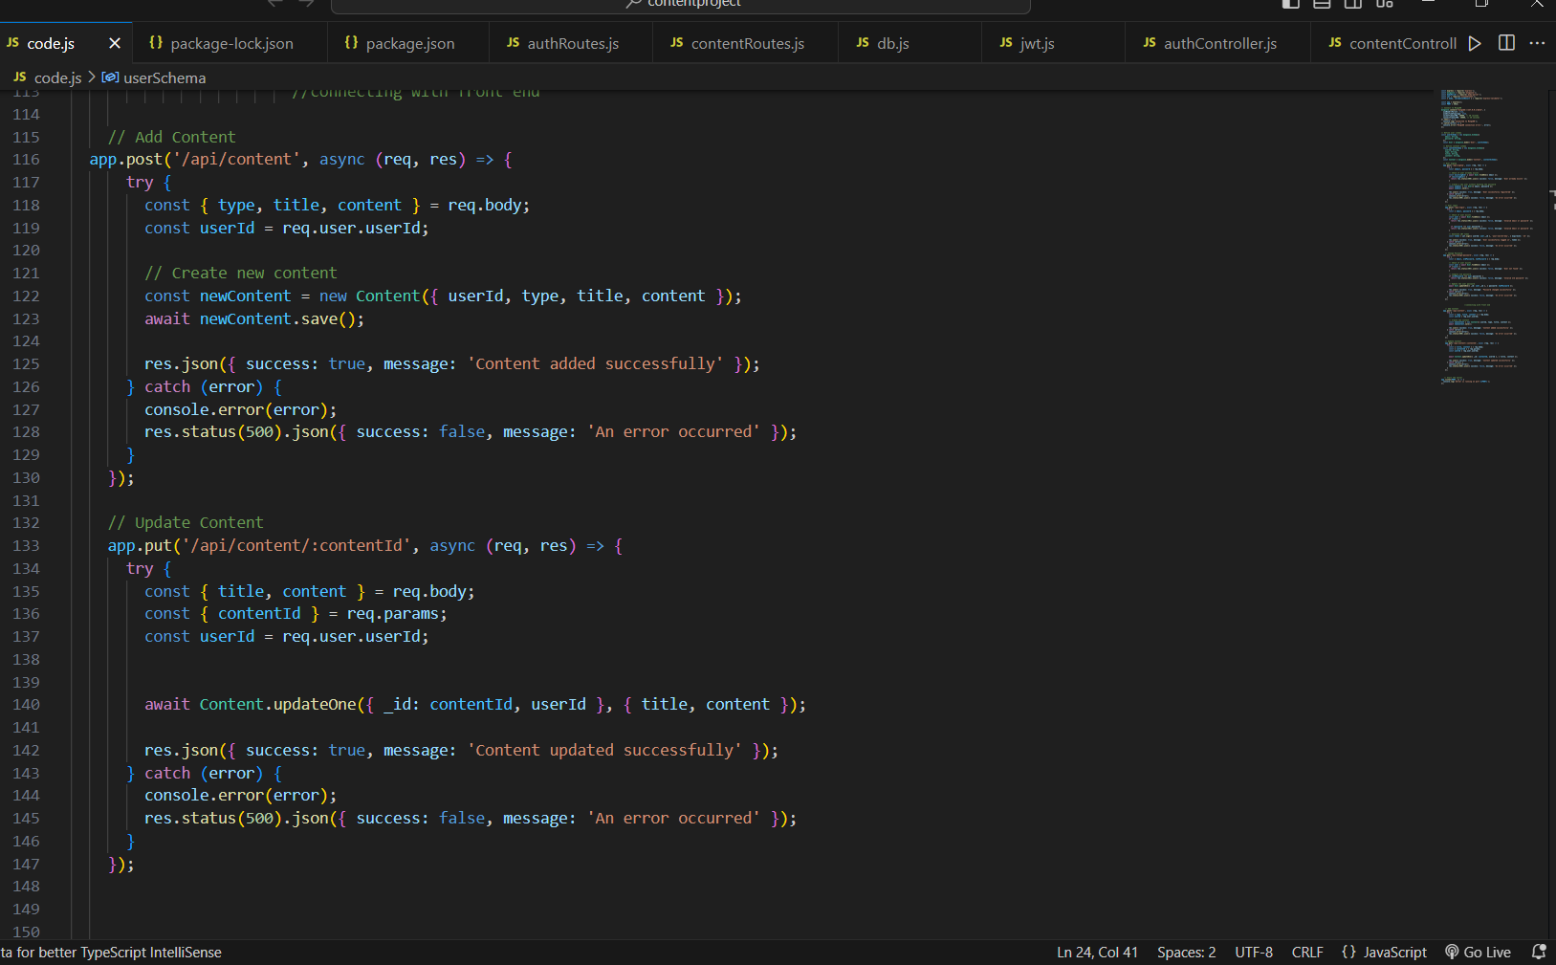
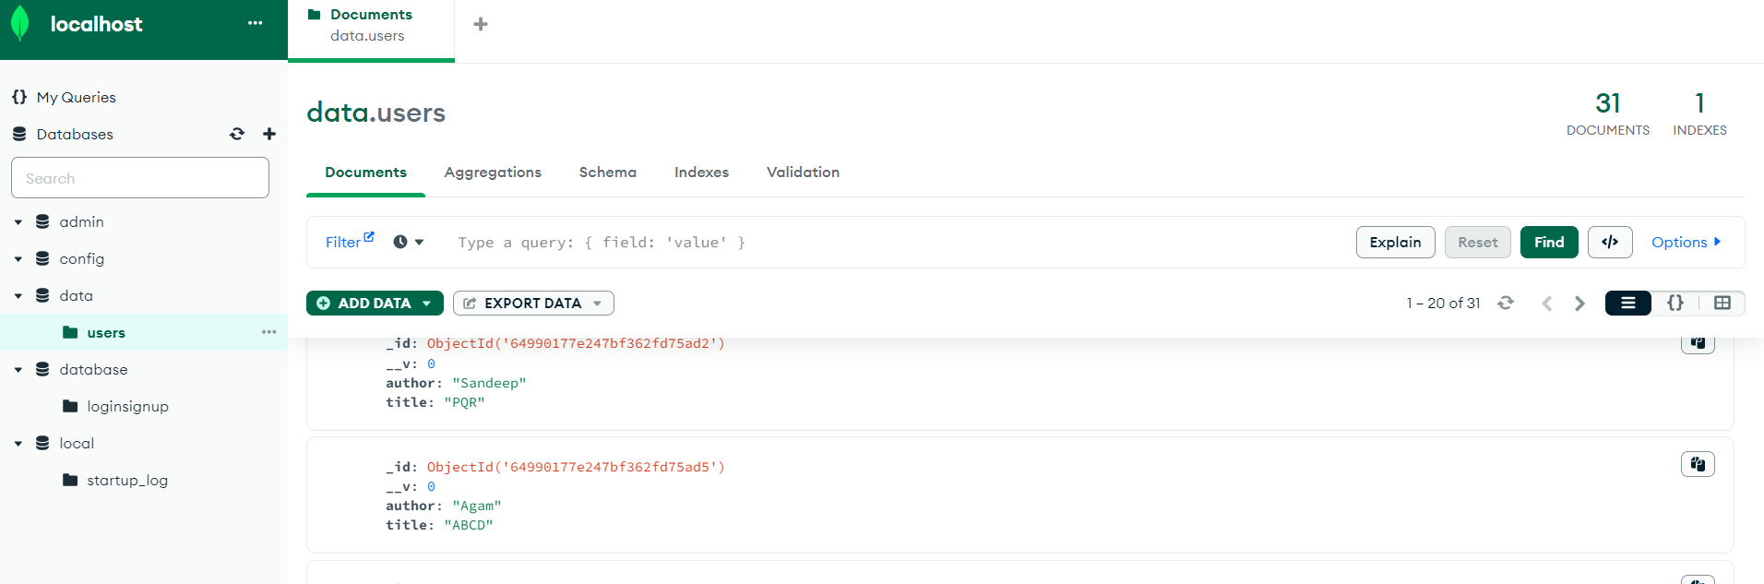
API Creation for Content Posting and Editing.

Slide 11
The food and beverage industry is facing growing competition, not only within India but also on a global scale, while simultaneously grappling with the need for enhanced traceability and inventory management systems with the help of emerging technologies such as Radio-Frequency Identification (RFID), Internet of Things (IoT), and blockchain. The problem at hand is two-fold: Competition Analysis: The first challenge is to comprehensively analyze the competitive landscape of the food and beverage industry, identifying the key players, market trends, and potential areas of disruption. Paramount Software Solutions seeks to understand how emerging technologies like RFID, IoT, and blockchain can be leveraged to gain a competitive edge in this dynamic market. Technology Solution Development: The second challenge involves the development of an innovative food traceability and inventory management system, referred to as the "Inventory Management System." particularly Node.js and API development skills are required to ensure efficient tracking and management of food products from production to consumption.
Problem Statement

Slide 12
THANK
YOU

